Slide 1
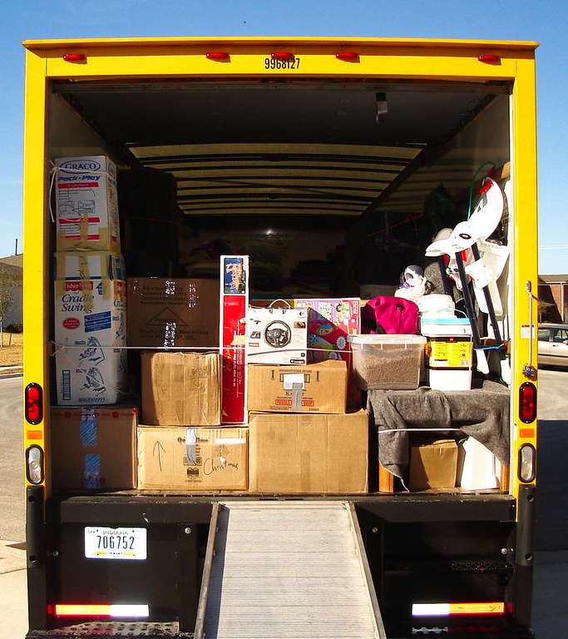
Load.in
Using AI and Computer Vision
to give your move a game plan.
Team Yellow
Design Presentation
Old Dominion University
11/15/2020
Notes:
1

Slide 2
Contents
Feasibility:
Team Biography
The Problem
Current Process Flow
The Solution
New Process Flow
Will & Will not do
Market Analysis
Risk and Mitigation
Competition
Design:
MFCD
Database
Sprint Plan
Conclusion
Misc:
Refrences
Glossary
User Stories
11/15/2020
CS 410 – Team Yellow – Load.In – Design
2
Notes:
2

Slide 3







Team Yellow
Byron Aquilino
Lance Perdue
Greg Kukanich
Jason Moran
Daniel Reyna
Chris Miller
Paul Rodriguez
11/15/2020
CS 410 – Team Yellow – Load.In – Design
3
Notes:
3

Slide 4
Problem Background

Slide 5

“Do It Yourself” movers lack the expert knowledge required to handle the logistics of their move.
This Photo by theritemove.com is licensed under CC BY
11/15/2020
CS 410 – Team Yellow – Load.In – Design
5
Notes:
5

Slide 6
Do it Yourself Moving
Professional movers reduces the time but increases cost
DIY reduces the cost but decreases efficiency
This is where Load.in Comes in
11/15/2020
CS 410 – Team Yellow – Load.In – Design
6
Notes:
6

Slide 7
Professional Movers are Costly
11/15/2020
CS 410 – Team Yellow – Load.In – Design
7
Notes:
7

Slide 8
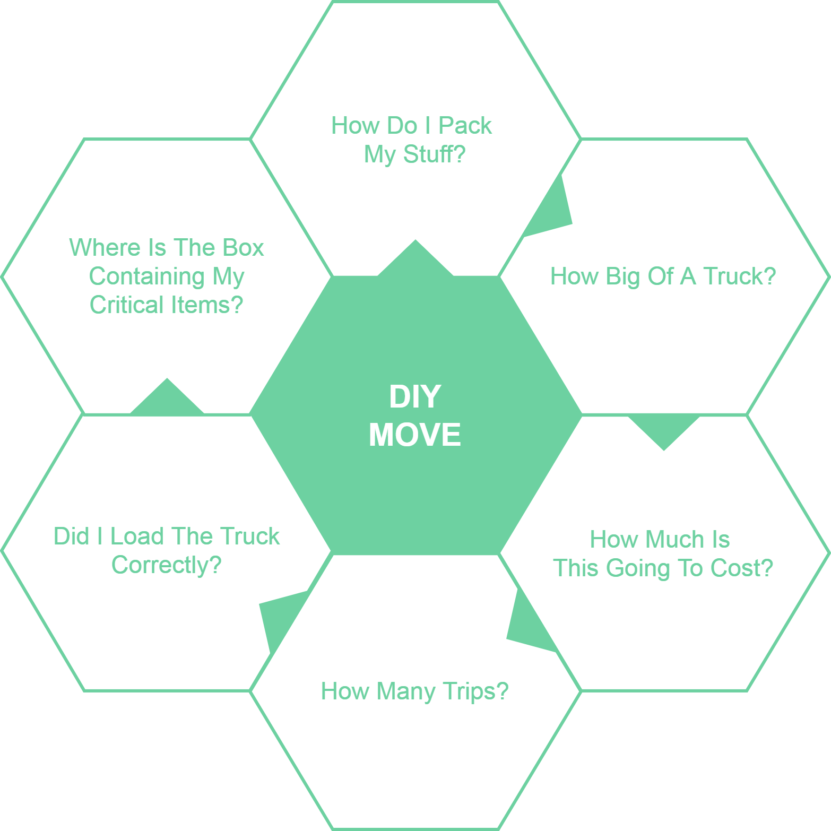
11/15/2020
CS 410 – Team Yellow – Load.In – Design
8
Notes:
8

Slide 9
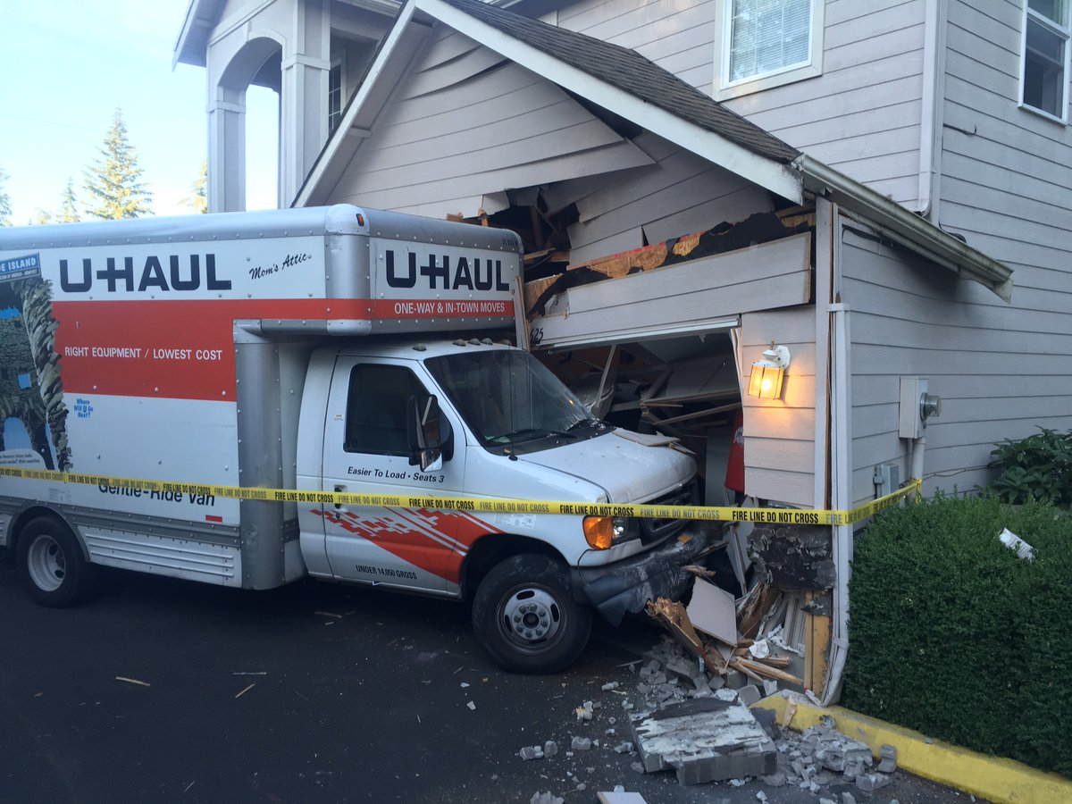
Loading can be a major issue
Poor loading can cause
Property damage
Car accidents
An estimated 50,000 accidents related to trailer towing occur each year.
This Photo by seattletimes.com is licensed under CC BY
Hayesbc.com
11/15/2020
CS 410 – Team Yellow – Load.In – Design
9
Notes:
9

Slide 10
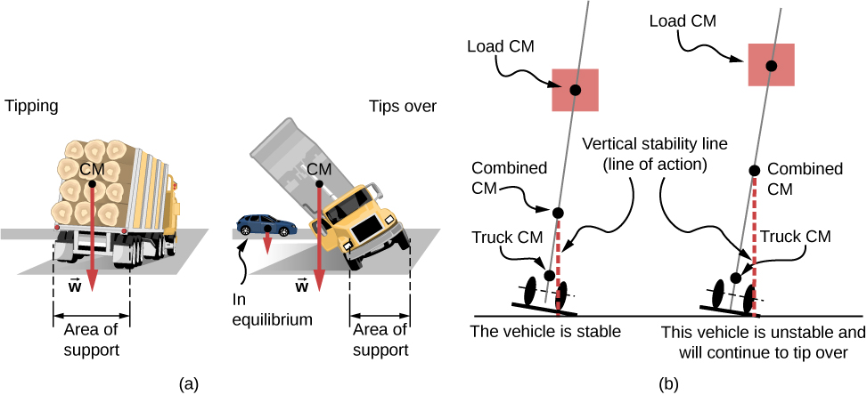

Major Truck Loading Considerations
Weight distribution
Protecting fragile items
This Photo by courses.lumenlearning.com is licensed under CC BY
This Photo by packlane.com is licensed under CC BY
PenskeTruckRental.com
11/15/2020
CS 410 – Team Yellow – Load.In – Design
10
Notes:
10

Slide 11
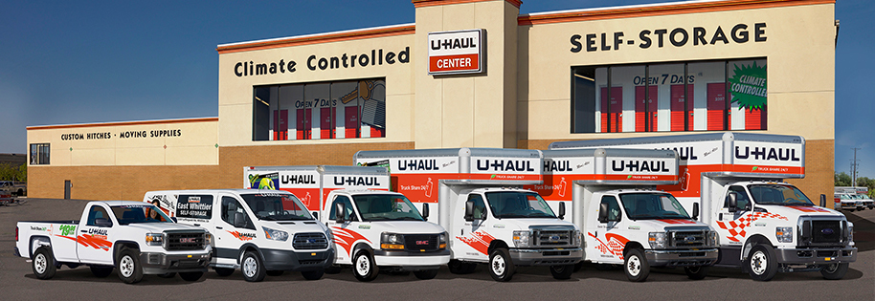
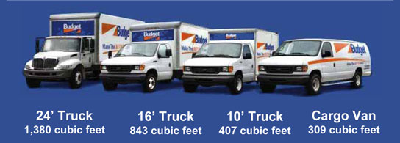
Figuring out what to rent is hard!
Accurately determining
How big of a truck to get
How many trips a move will take …is difficult.
Rental Truck companies base their business model on this!
This Photo by uhaul.com is licensed under CC BY
This Photo by truckbodyeast.com is licensed under CC BY
wtkr.com
11/15/2020
CS 410 – Team Yellow – Load.In – Design
11
Notes:
11

Slide 12
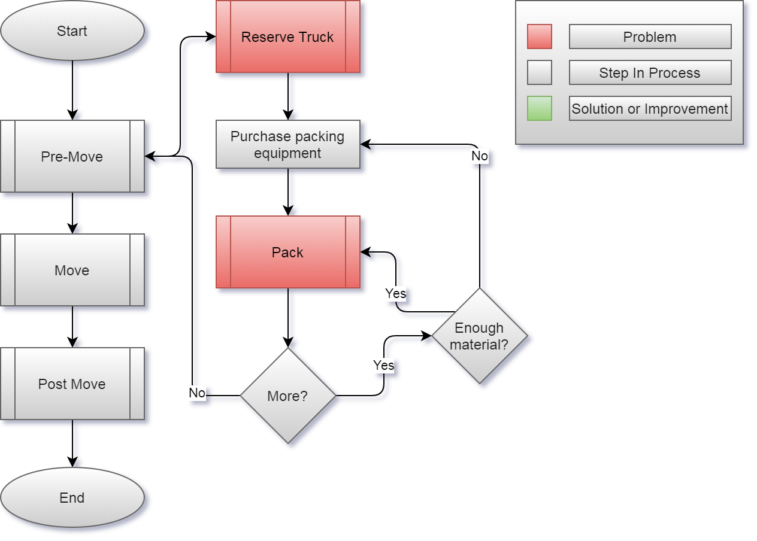
Current Process
11/15/2020
CS 410 – Team Yellow – Load.In – Design
12
Notes:
12

Slide 13
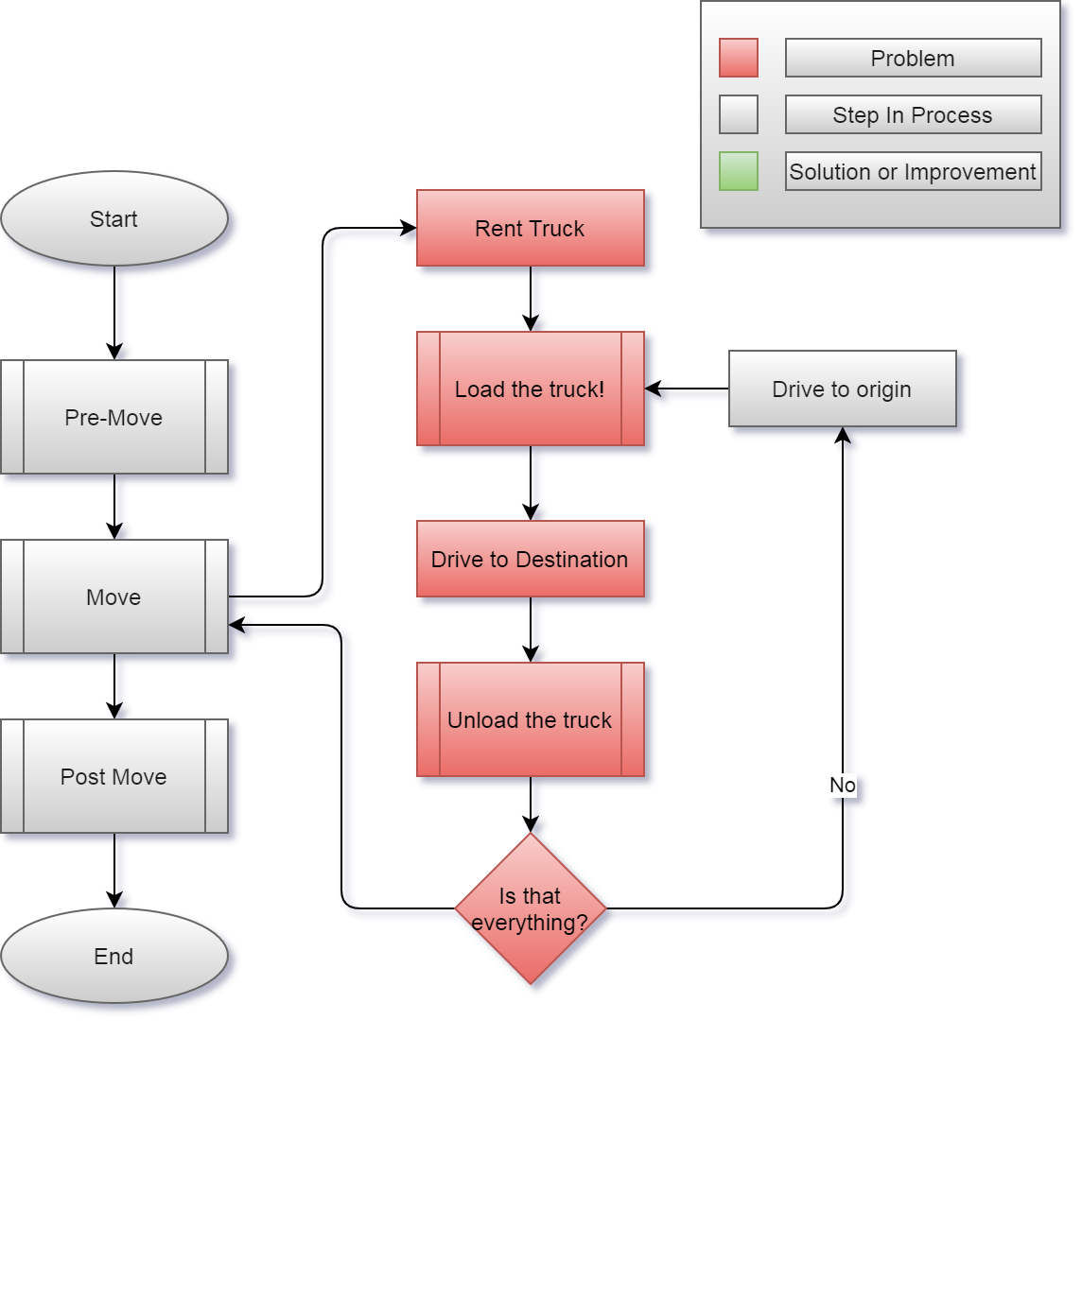
11/15/2020
CS 410 – Team Yellow – Load.In – Design
13
Notes:
13

Slide 14

Customers and End Users
Do it yourself Movers
Looking to save on
Time
Money
Stress
Anxiety
Moving Rental Companies
Looking to appeal more to DIY movers
Increase revenue while reducing risk
CS 410 – Team Yellow – Load.In – Design

Slide 15
Benefits to Customer
Do It Yourself Mover
Being shown how to
Pack boxes for increased organization
Properly load their truck for increased efficiency
Being provided with expert advice
Database full of tips that a user can search through with keywords
Live-chat support for questions not answered through the tips
Saving of Time and Money
Increased efficiency will lead to less trips and materials used
Peace of Mind
Fragile items being safely transported
Moving Rental Companies
Become more appealing to do it yourself movers
Being able to provide them with a game plan in their move process
Reduce Risk and Increase Revenue
Load.In provides plan and reduces time but still leads to truck rentals
CS 410 – Team Yellow – Load.In – Design

Slide 16
Solution Description

Slide 17

Load.In gives your move a game plan
Uses artificial intelligence and computer vision
Provides
Expert-level instructions
Tips and tricks on moving day
This Photo by realtor.com is licensed under CC BY
11/15/2020
CS 410 – Team Yellow – Load.In – Design
17
Notes:
17

Slide 18
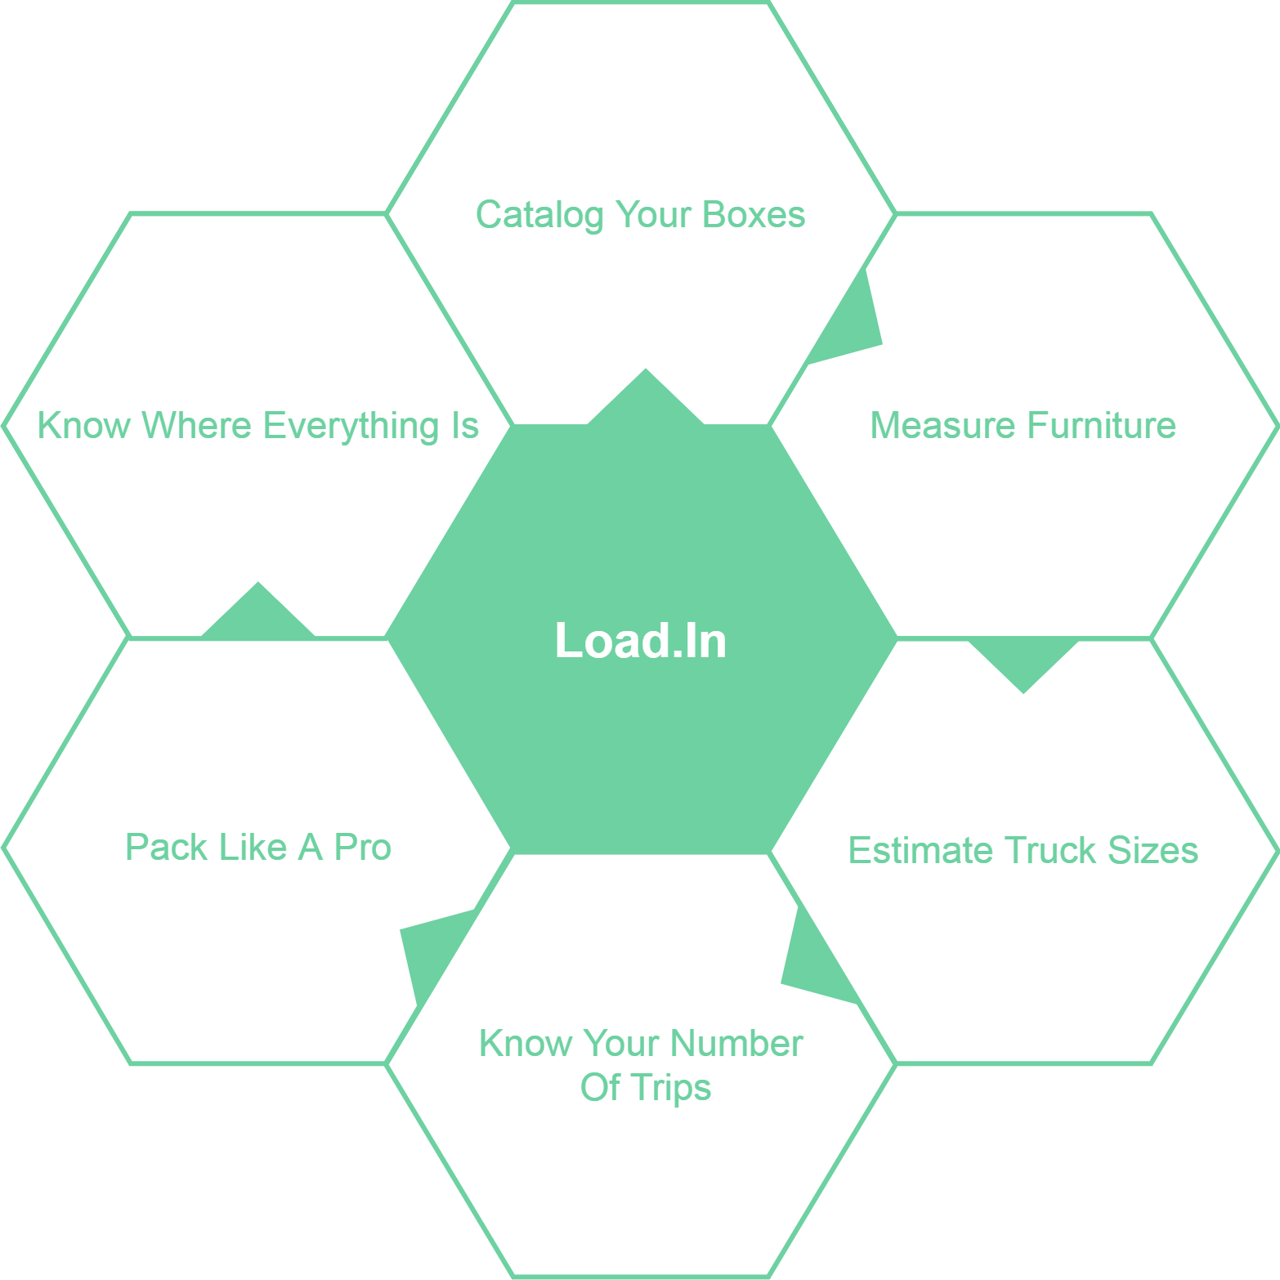
What Can Load.In Do
For You?
11/15/2020
CS 410 – Team Yellow – Load.In – Design
18
Notes:
18

Slide 19
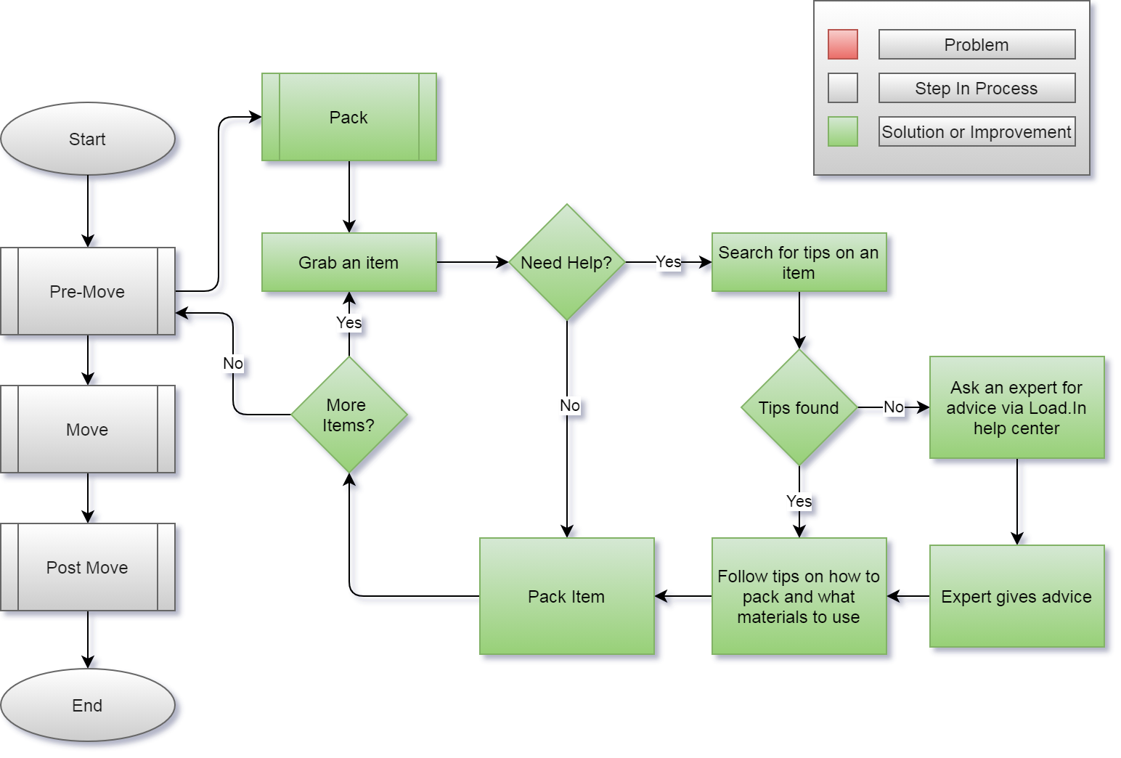
How will the solution help?
11/15/2020
CS 410 – Team Yellow – Load.In – Design
19
Notes:
19

Slide 20
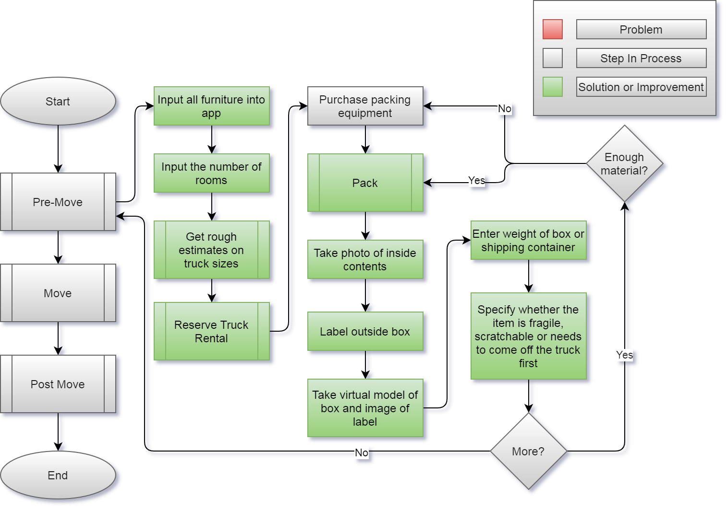
11/15/2020
CS 410 – Team Yellow – Load.In – Design
20
Notes:
20

Slide 21
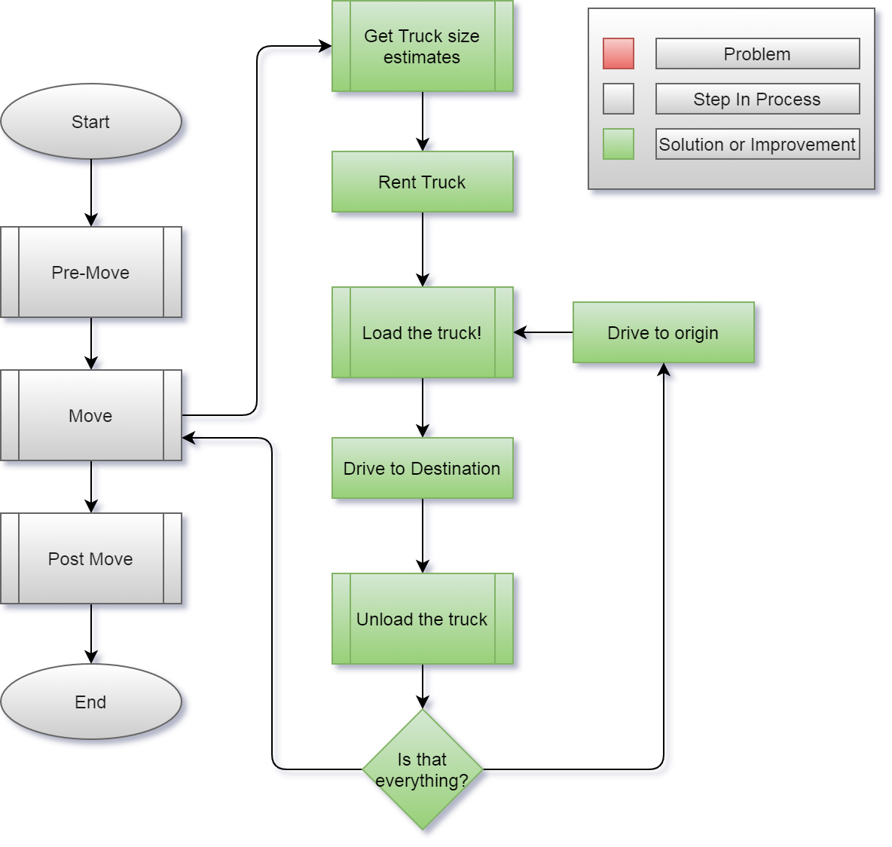
11/15/2020
CS 410 – Team Yellow – Load.In – Design
21
Notes:
21

Slide 22
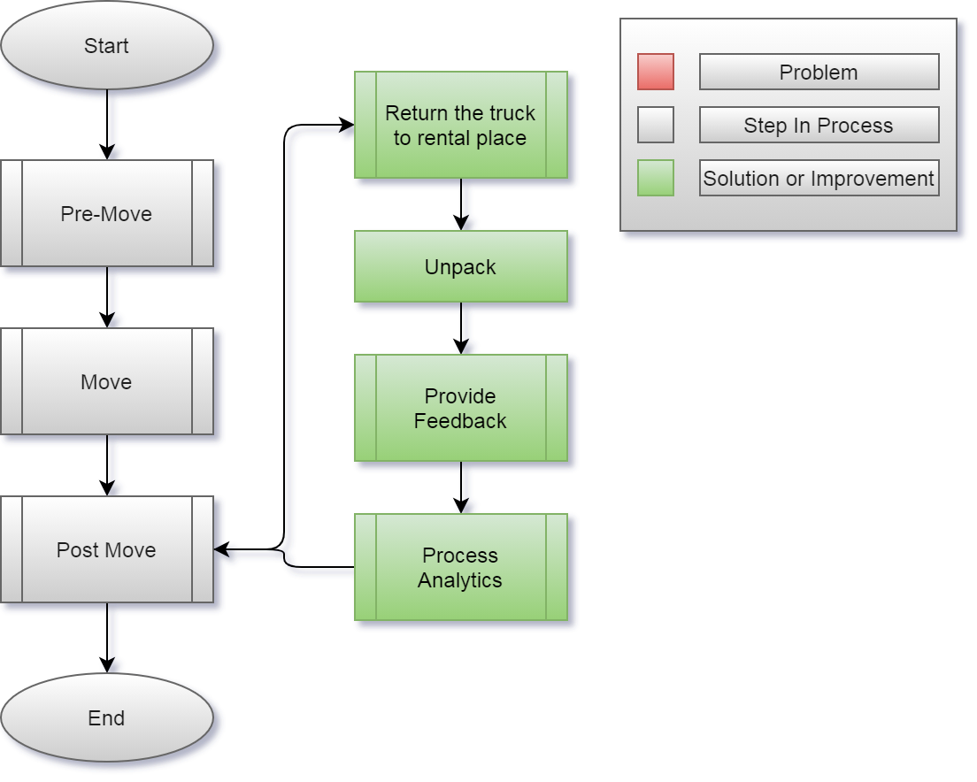
11/15/2020
CS 410 – Team Yellow – Load.In – Design
22
Notes:
22

Slide 23
What Load.In Will Do
Assist in the packing process with expert advice
Catalog with photos all boxes, furniture, and other items that are going to be placed in the truck
Generate instructions for properly loading the truck based on weight distribution, item safety, best fit space utilization, and item(s) priority
Use photos taken to Create a 3D model of how everything should be expertly packed in the truck
Will provide location information for different boxes and items within the truck using 3D model and cataloging
Give estimate for appropriate rental truck size and number of trips dependent on truck size
11/15/2020
CS 410 – Team Yellow – Load.In – Design
23
Notes:
23

Slide 24
What Load.In Won’t Do
Pack boxes
Load or unload truck
Assist in the driving process
11/15/2020
CS 410 – Team Yellow – Load.In – Design
24
Notes:
24

Slide 25
Design Approach

Slide 26
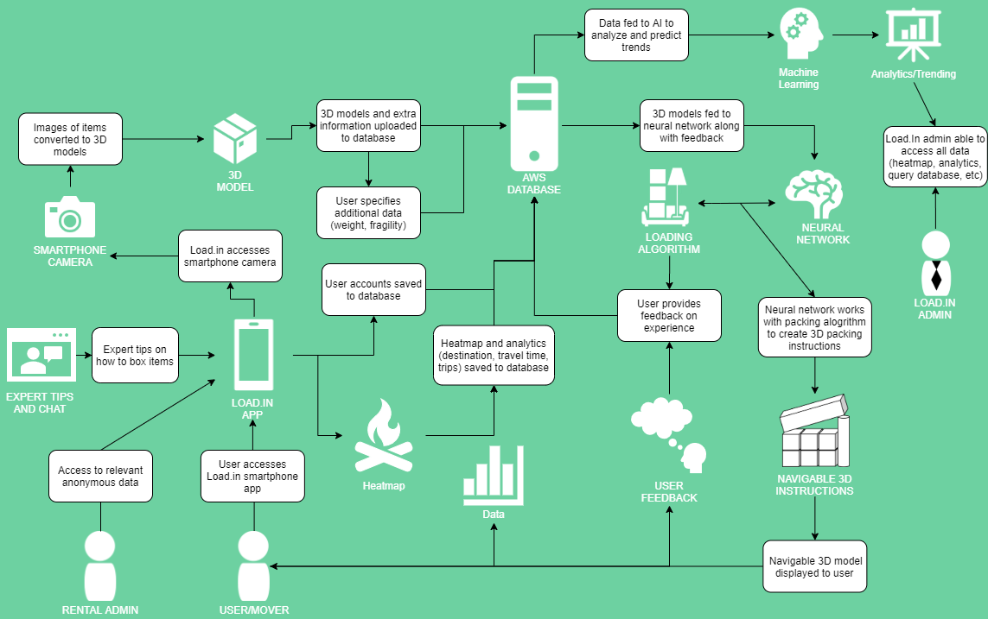
Major Functional Components
11/15/2020
CS 410 – Team Yellow – Load.In – Design
26
Notes:
26

Slide 27











Feedback Loop
4
3
Input
Training data
6
5
2
1
Pro loading strategy
Neural Network
Output
App generates 3D models of objects to move
Incorporate Feedback in to training data generation
Experience
Instructions
User gives feedback
User follows plan
Loading Plan
11/15/2020
CS 410 – Team Yellow – Load.In – Design
27
Notes:
27

Slide 28
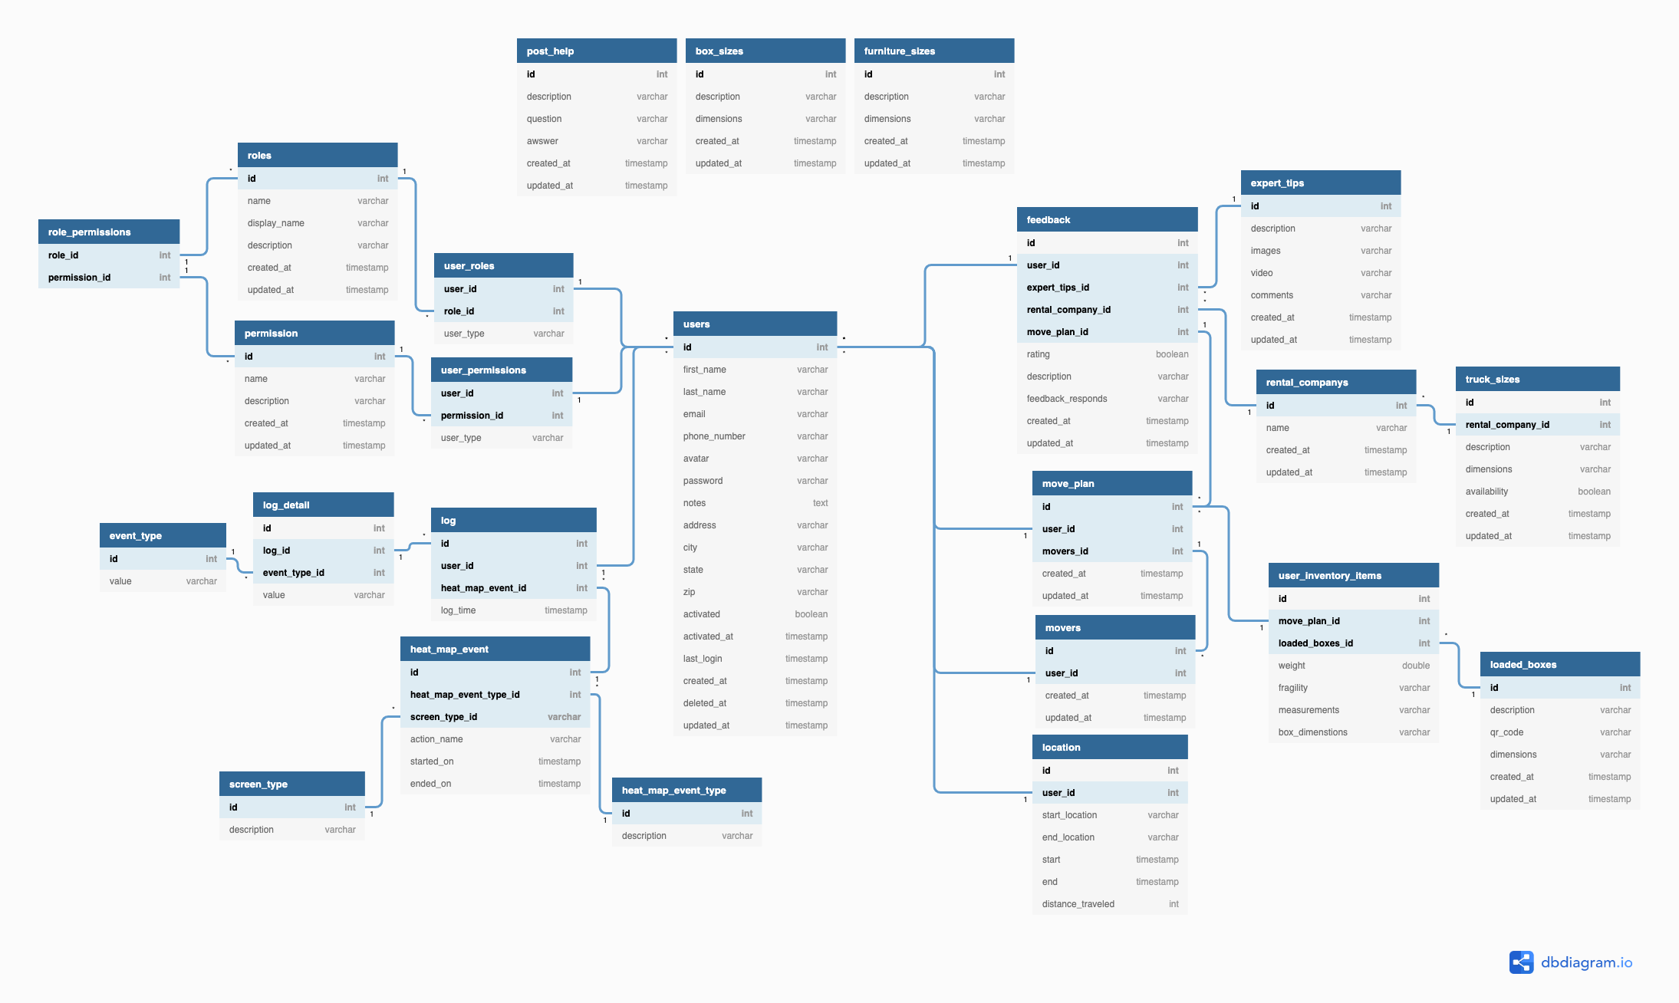
Database Schema
CS 410 – Team Yellow – Load.In – Design
28

Slide 29
Data Management
Amazon RDS MySQL
High Performance and Scalability
Long Term Storage
Amazon EFS
Storage of BLOB data such as photos
Creates snapshots of database
CS 410 – Team Yellow – Load.In – Design
29

Slide 30
Sprint Breakdown
Sprint 1
Sprint 2
Sprint 3
Sprint 4
Core feedback loop
Deployment Infrastructure
Framework for major components
Initial implementation of Photogrammetry
Initial implementation of help features
Improved Photogrammetry
Initial Implementation of Packing Algorithm
Improved Packing Algorithm
Improved Photogrammetry
CS 410 – Team Yellow – Load.In – Design
30

Slide 31
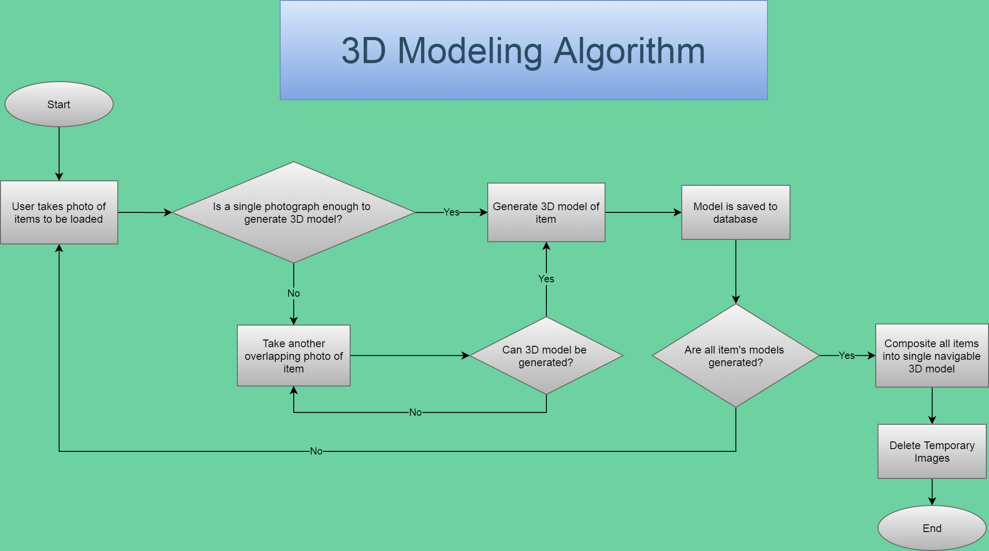
CS 410 – Team Yellow – Load.In – Design
31

Slide 32
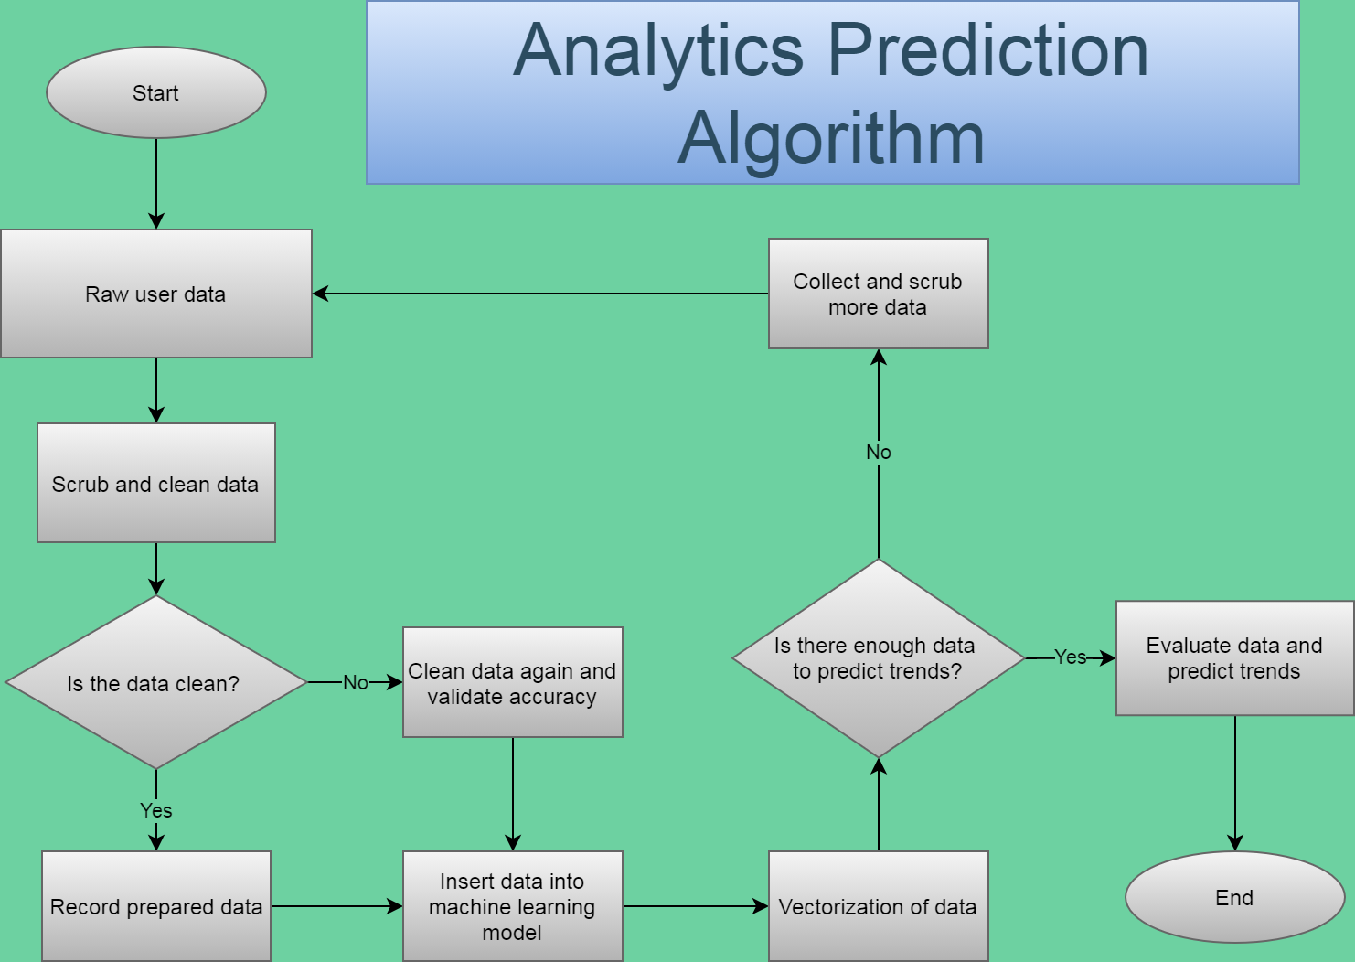
CS 410 – Team Yellow – Load.In – Design
32

Slide 33
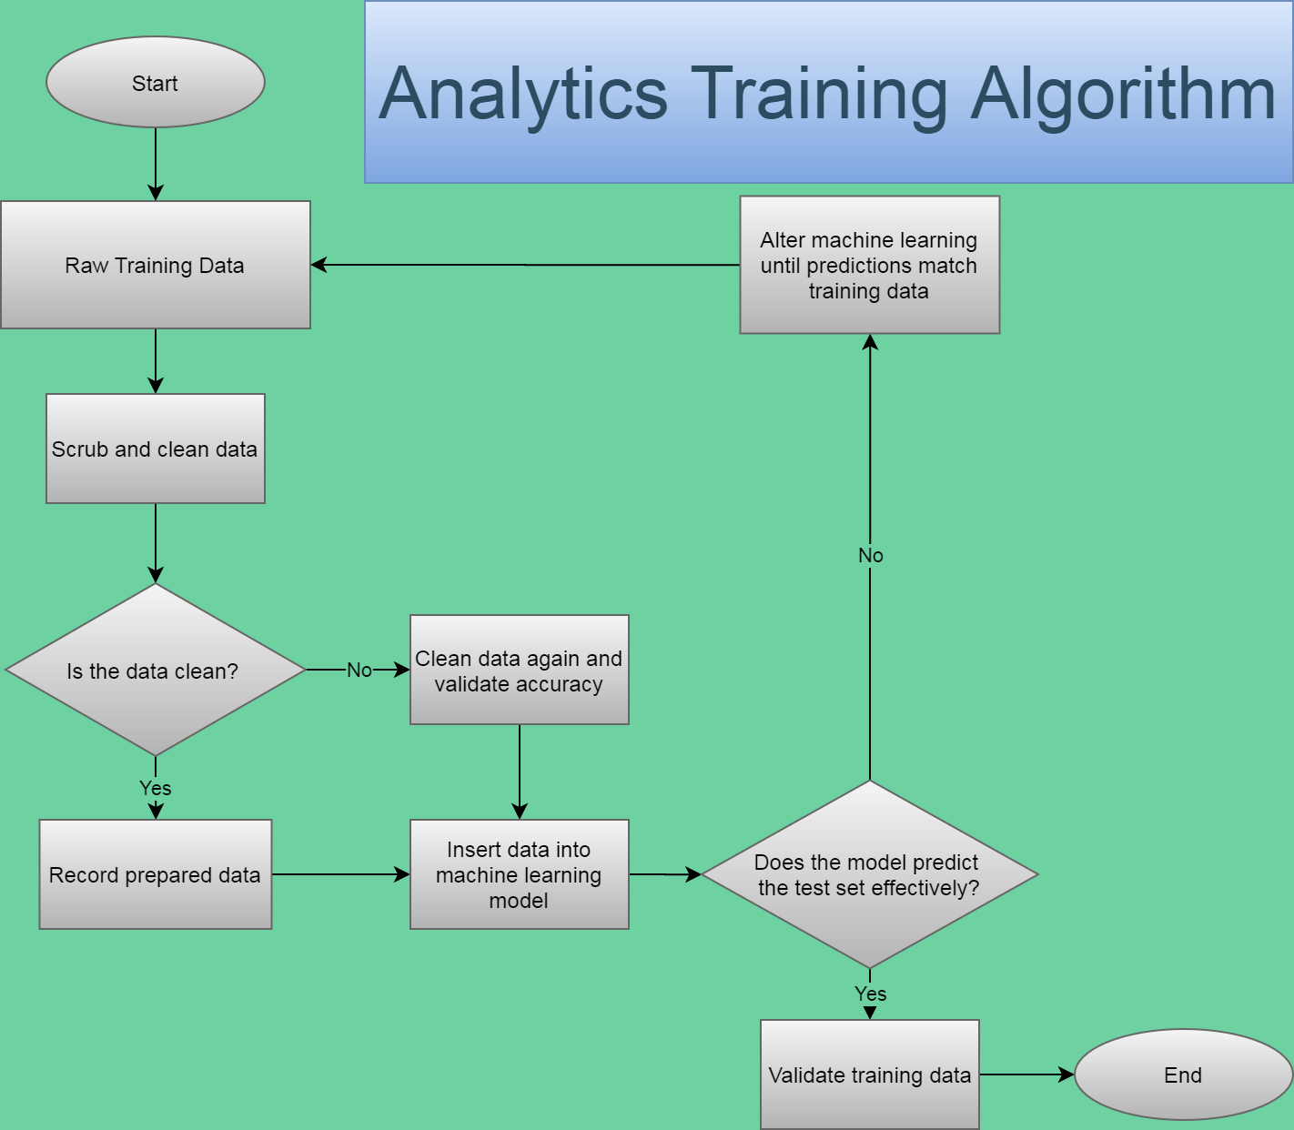
CS 410 – Team Yellow – Load.In – Design
33

Slide 34
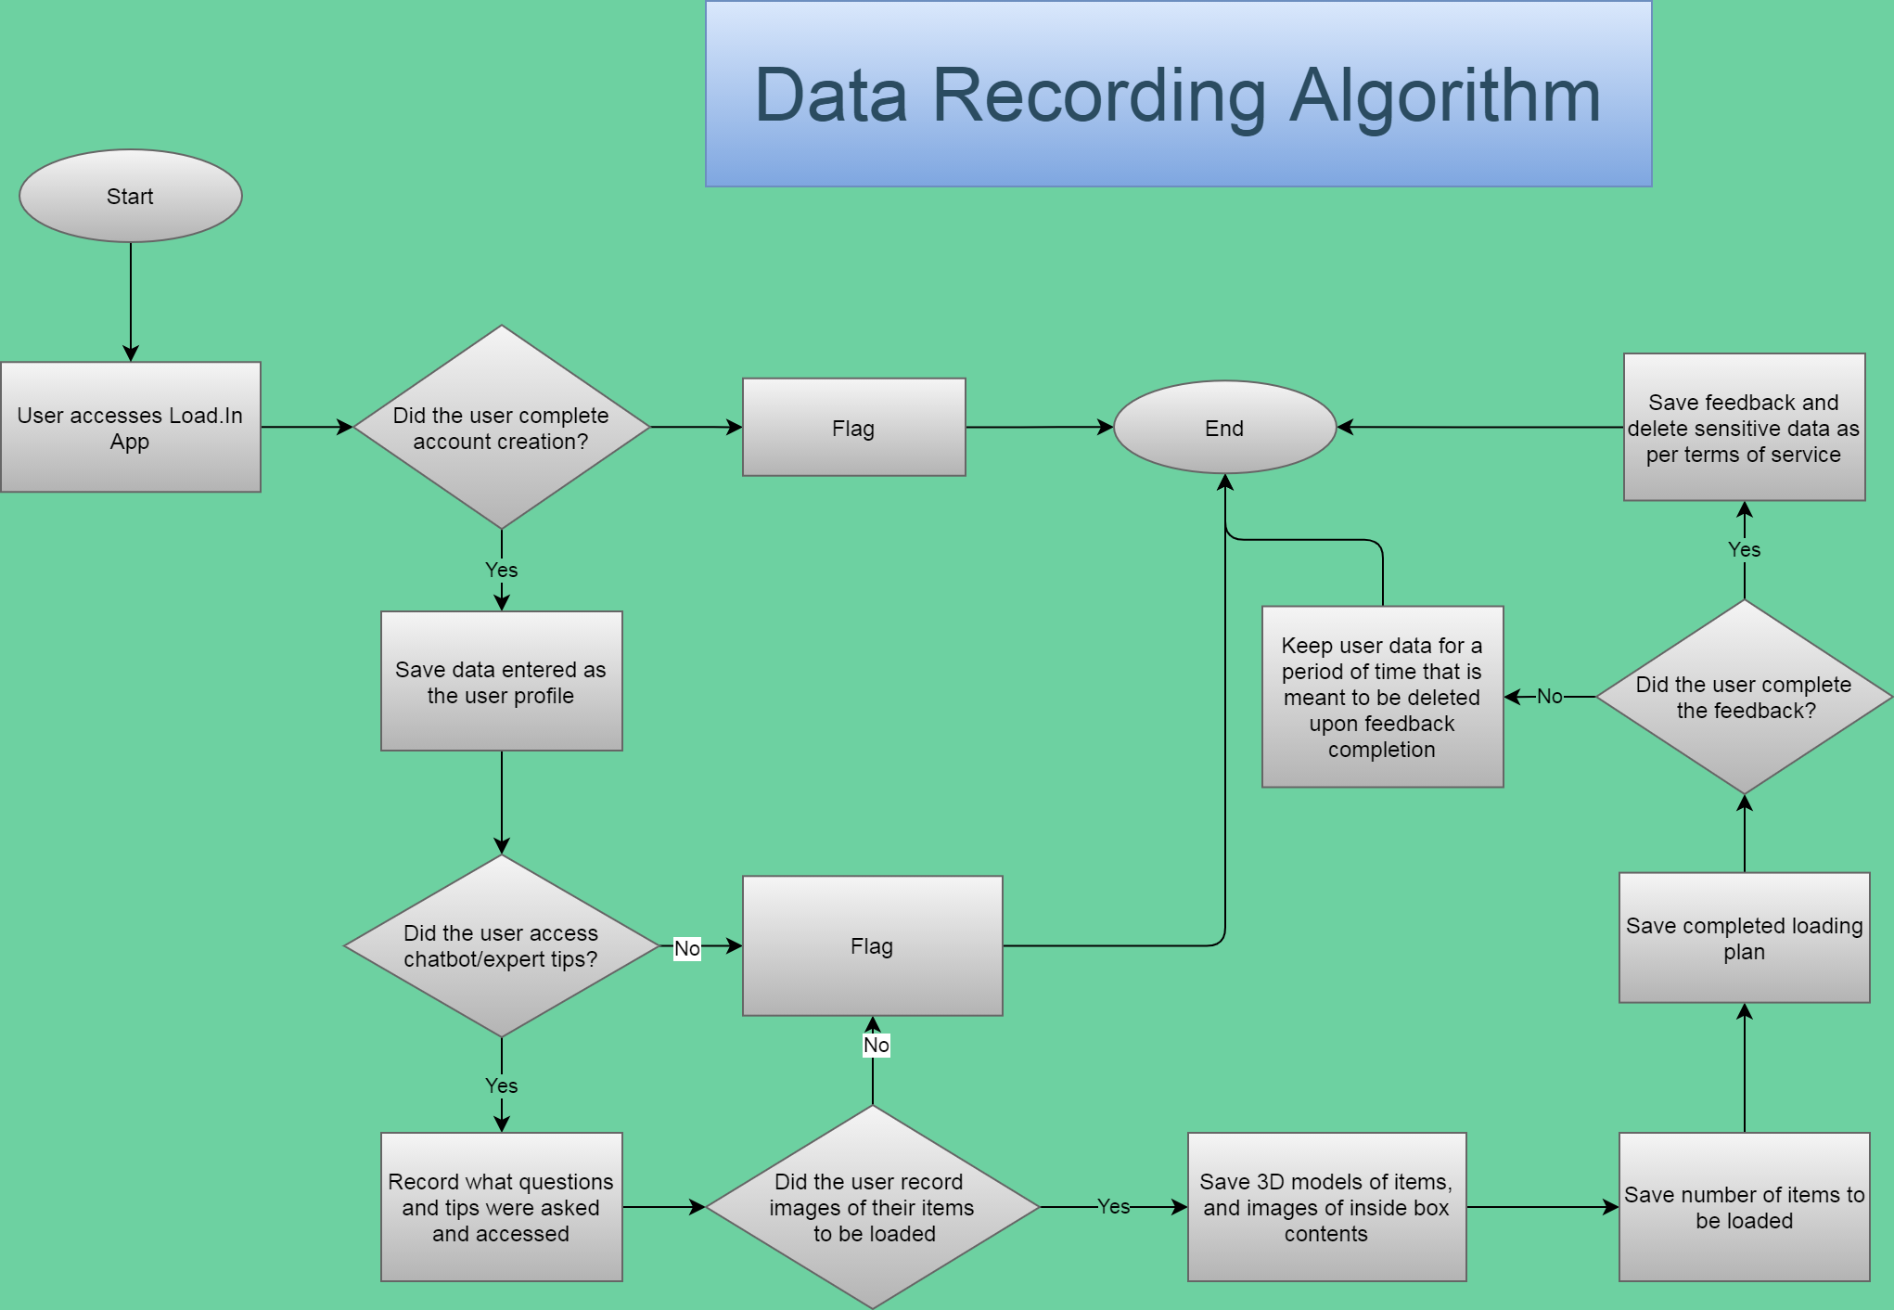
CS 410 – Team Yellow – Load.In – Design
34

Slide 35
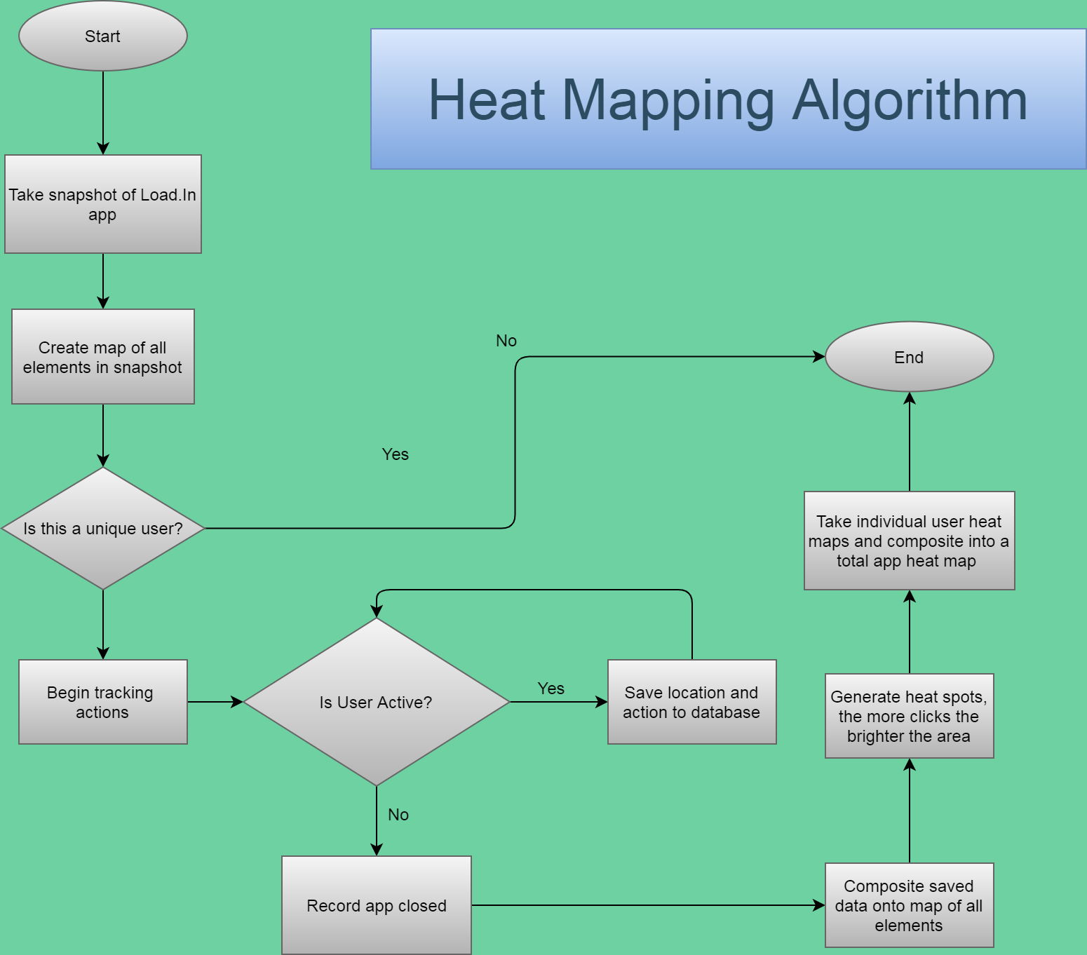
CS 410 – Team Yellow – Load.In – Design
35

Slide 36
Developer Tools
Category | Website | Android App | Web API | Vendor Scraper/ API Reader
Version Control | GitLab/Git
Issue Tracker | Trello
CI/CD | GitLab
Language | Java/HTML/JavaScript | Java | Java | Java
Platform | Spring MVC on Amazon Elastic Beanstalk with Tomcat | Android Native App | Apache CFX on Amazon Elastic Beanstalk with Tomcat | AWS Lambda
Database | MySQL (or Aurora) on AWS RDS
IDEs | IntelliJ | Android Studio | IntelliJ | IntelliJ
Developer OS on Virtual Machine (or VDI) | Linux
CS 410 – Team Yellow – Load.In – Design
36

Slide 37
Risk & Mitigation

Slide 38
Technical Risks
Probability
 |  | Very Low | Low | Medium | High | Very High
Severity | Very High |  |  |  |  | T-1
 | High |  |  |  | T-2
 | Medium |  |  | T-3
 | Low
 | Very Low
T-1: Current technology involving computer vision is a challenge.
T-1 Mitigation: Conduct a prototype to mitigate risk of critical errors upon release.
T-2: Artificial Intelligence prone to error due to insufficient training data.
T-2 Mitigation: Implementing a feedback loopback in the beta phase with test users.
T-3: Challenge to obtain accurate and timely feedback.
T-3 Mitigation: Implement a feature for users to give feedback if the application operated correctly after completing a move.
11/15/2020
CS 410 – Team Yellow – Load.In – Design
38
Notes:
38

Slide 39
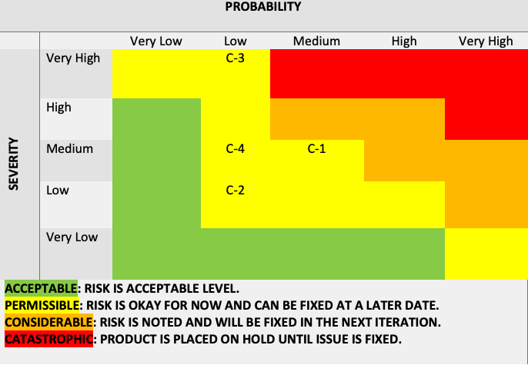
Customer Risks
C-1: End user is inexperienced with the application.
C-1 Mitigation: Implement a tutorial on how to use the application and provide a help feature.
C-2: End user finds UI challenging to operate.
C-2: Mitigation: Implement analytics for tracking when a user stop using the application.
C-3: End users are not satisfied with the recommendations of the application.
C-3 Mitigation: Implement a customer feedback feature that allows the users to disclose his/her issues with the applications.
C-4: End user doesn’t follow the guidelines of the application.
C-4 Mitigation: Implement a feature that allows the user to repeat/reset certain steps in the application as they progress.
Probability
 |  | Very Low | Low | Medium | High | Very High
Severity | Very High
 | High |  | C-1
 | Medium |  | C-2 | C-3
 | Low |  |  |  | C-4
 | Very Low
11/15/2020
CS 410 – Team Yellow – Load.In – Design
39
Notes:
39

Slide 40
Conclusion
DIY Movers are faced with many logistical difficulties
Properly loading truck
Protecting valuables
Finding the best deal
Keeping track of every box
All during an already stressful life event!
Load.In will provide customized expert instructions
Truck loading instructions based on photogrammetry
Cost minimization based on input data
Map of truck available to assist in finding boxes
Provide unique insights to moves due to captured analytics
11/15/2020
CS 410 – Team Yellow – Load.In – Design
40
Notes:
40

Slide 41
41
Notes:
41

Slide 42
Sources:
The Top 5 Moving Mistakes Across America. (2019, August 13). Article. https://www.article.com/blog/top-5-moving-mistakes/
Economy Moving & Storage, LLC. (2015, January 4). How to properly pack and load a moving truck- Movers Cincinnati. YouTube. https://www.youtube.com/watch?v=rjmofUZOdwo&feature=youtu.be
CADCode Systems. (n.d.). Optimizing & Machining | CADCode Systems. CADCode.Com. Retrieved September 20, 2020, from https://www.cadcode.com/category/categories/optimizing-machining
Dube, E. (2020, September 20). OPTIMIZING THREE-DIMENSIONAL BIN PACKING THROUGH SIMULATION. Semantics Scholar. https://www.semanticscholar.org/paper/OPTIMIZING-THREE-DIMENSIONAL-BIN-PACKING-THROUGH-Dube/bb9986af2f26f7726fcef1bc684eac8239c9b853#references
Knoblauch, M. (2019, May 8). One in ten Americans would prefer a week in jail over moving. New York Post. https://nypost.com/2019/05/08/one-in-ten-americans-would-prefer-a-week-in-jail-over-moving/
The American Institute of Stress. (n.d.). The Holmes-Rahe Stress Inventory PDF. Retrieved September 20, 2020, from https://www.stress.org/wp-content/uploads/2019/04/stress-inventory-1.pdf
Wood, T. (2020, January 6). Moving Industry Statistics. MoveBuddha. https://www.movebuddha.com/blog/moving-industry-statistics/
Nat and Friends. (2017, April 18). Google Earth’s Incredible 3D Imagery, Explained. YouTube. https://www.youtube.com/watch?v=suo_aUTUpps&feature=youtu.be
Collins, T. (2018, April 20). A Look Into Photogrammetry and Video Games - Tiger Collins. Medium. https://medium.com/@homicidalnacho/a-look-into-photogrammetry-and-video-games-71d602f51c31
11/15/2020
CS 410 – Team Yellow – Load.In – Feasibility
42
Notes:
42

Slide 43
Glossary:
*All definitions are sourced from Wikipedia
Photogrammetry
Photogrammetry is the science and technology of obtaining reliable information about physical objects and the environment through the process of recording, measuring and interpreting photographic images and patterns of electromagnetic radiant imagery and other phenomena.
Algorithm
A finite sequence of well-defined, computer-implementable instructions, typically to solve a class of problems or to perform a computation.
Professional movers
Professionals who move all your belongings for you from one place to another.
Packing problems
Are a class of optimization problems in mathematics that involve attempting to pack objects together into containers. The goal is to either pack a single container as densely as possible or pack all objects using as few containers as possible.
11/15/2020
CS 410 – Team Yellow – Load.In – Feasibility
43
Notes:
43

Slide 44


User Roles
Mover
Move Expert
Rental Company Representative
Do it yourself mover
Looking to reduce the cost and time needed to move
Expert in the moving industry
Provides tips and advice to DIY movers
Employee of a moving rental company
Can provide customer with rental truck and materials
CS 410 – Team Yellow – Load.In – Design
44

Slide 45



User Roles
Website Visitor
Chat-Bot Manager
Administrator
Do it yourself mover accessing website
Looking for help on their move
User who communicates with customer when FAQ fails
System super user
Has ability to access internal systems for user support
CS 410 – Team Yellow – Load.In – Design
45

Slide 46

User Roles
Tester
Will assume any of the other roles
Will input fake data to test systems for errors
CS 410 – Team Yellow – Load.In – Design
46

Slide 47
Slides from the feasibility presentation not called out by name in the design rubric but why delete them?

Slide 48

The Moving Industry Market
Nearly all moving companies are either all inclusive or DIY
However the all-inclusive services are often very expensive
All the DIY services provide no assistance or guidance and lead to confusion and wasted money
The market is shifting towards software being utilized to increase efficiency and decrease costs
This Photo by technavio.com is licensed under CC BY
11/15/2020
CS 410 – Team Yellow – Load.In – Feasibility
48
Notes:
48

Slide 49
Benefits to the Customer
Being shown how to
Pack boxes for increased organization.
Properly load their truck for increased efficiency.
Being provided with a database of useful tips from professional movers.
Saving of money and time due to the entire moving process being made more efficient.
Peace of mind about fragile items safely transported
11/15/2020
CS 410 – Team Yellow – Load.In – Feasibility
49
Notes:
49

Slide 50
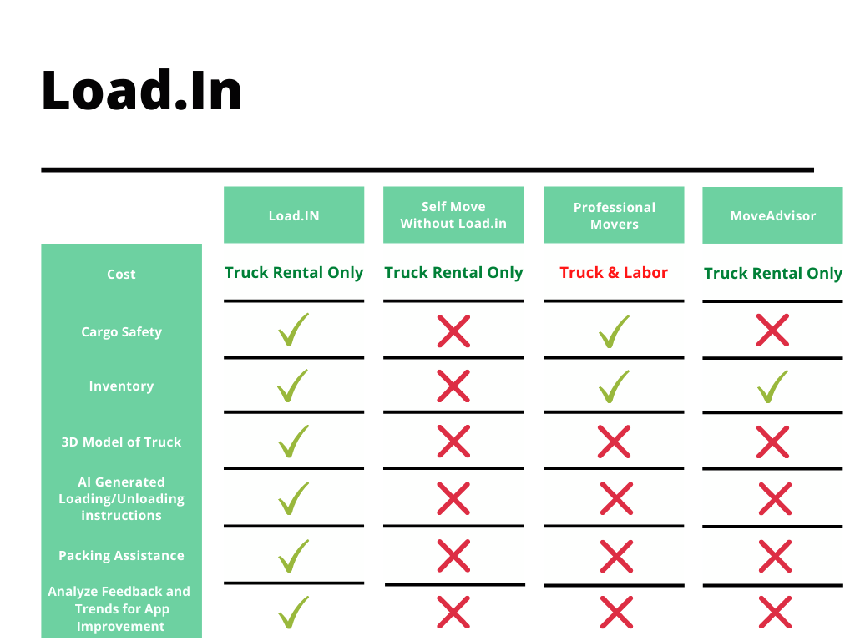
The Competition
11/15/2020
CS 410 – Team Yellow – Load.In – Feasibility
50
Notes:
50

